Slide 1
Oakwood Homes
Building Your Presentation
The latest version of this template can always be downloaded here: http://inside.oakwoodhomesco.com/corporate-templates/presentations/
Please use the following base slides as your template. We encourage you to use multiple slide styles to build your presentation. Hint: They have different backgrounds.
If another slide of a certain style is needed - you can duplicate it. Simply, right click the slide within the left panel and select ‘Duplicate Slide’. If a slide type was deleted from the left panel - you can get a new one. Simply, select the ‘Home’ tab and click the small down arrow on the ‘New Slide’ button. This will show a dropdown of different slide options available to you. Feel free to explore!
To change text color, select the ‘Home’ tab, click the small arrow on the letter ‘A’ button with the red block, select ‘More Colors’ at the bottom, select ‘RGB Sliders’, and enter the hex color # of your choice.
Oakwood Blue: # 1A3464
Oakwood Green: # 97D700
Cool Gray: # 76777B
Sage: # 85B09A

Slide 2
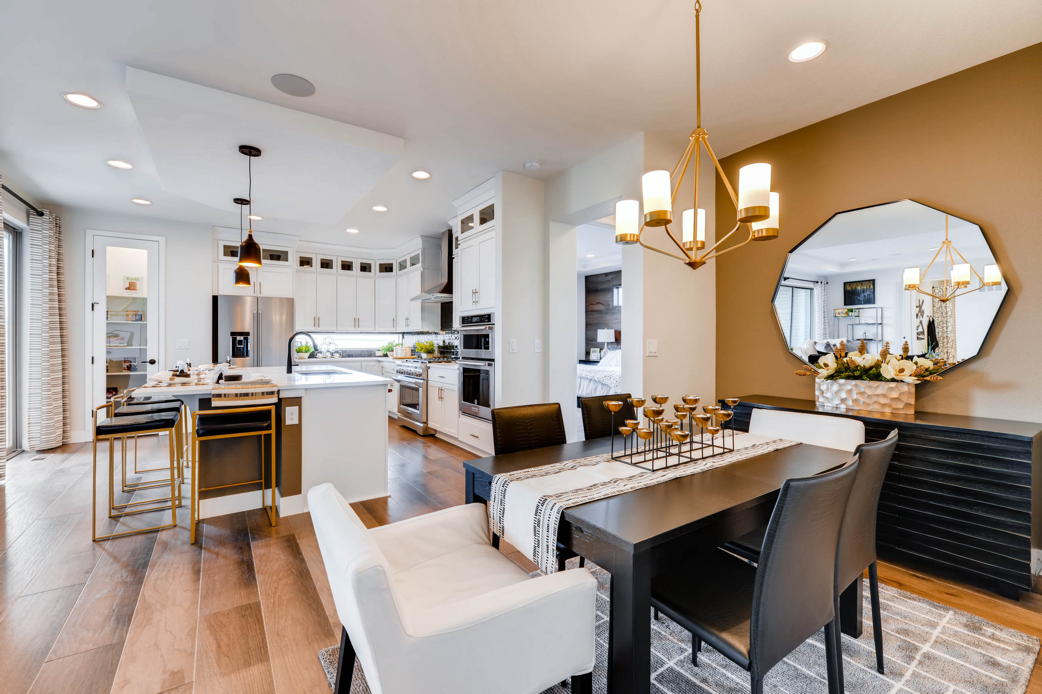
Oakwood Homes
Master Slides
If you click something in your presentation and it will not select, most likely it is locked into the master slide.
To access the master slide, select the ‘View’ tab then click ‘Slide Master’.
This will open up the template of your PowerPoint. You should not have to edit this often – as these are set according to brand guidelines.
Important: Edits you make in the master slide will affect all slides in your presentation.
To get back to your presentation after editing the master, select the ‘Slide Master’ tab and click the red ‘X’ to ‘Close Master’.

Slide 3

























Oakwood Homes
Icons
This is a basic icon set that is available for your presentation.
Size & color are adjustable. If you have any suggestions for new icons please contact the Support Marketing Department.

Slide 4
Cover Title Slide 1
Subheader Title 1

Slide 5
Cover Title Slide 2
Subheader Title 3

Slide 12
Oakwood Homes
Body Slide 1

